Slide 1

Lead Scoring Case Study
Yadeesh K R
Harshal Manish Raikar
Abhishek Raikwar
Chandra Bhushan

Slide 2
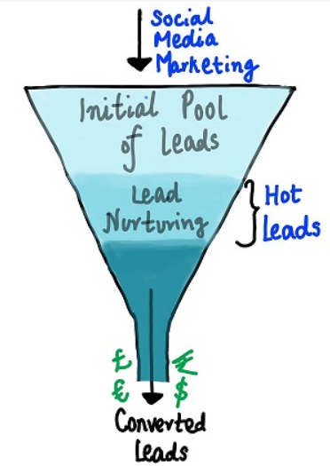
Case Description
An education company named X Education sells online courses to industry professionals. On any given day, many professionals who are interested in the courses land on their website and browse for courses. When these people fill up a form providing their email address or phone number, they are classified to be a lead. Moreover, the company also gets leads through past referrals. Once these leads are acquired, employees from the sales team start making calls, writing emails, etc. Through this process, some of the leads get converted while most do not. The typical lead conversion rate at X education is around 30%.
Now, although X Education gets a lot of leads, its lead conversion rate is very poor. For example, if, say, they acquire 100 leads in a day, only about 30 of them are converted. To make this process more efficient, the company wishes to identify the most potential leads, also known as ‘Hot Leads’. If they successfully identify this set of leads, the lead conversion rate should go up as the sales team will now be focusing more on communicating with the potential leads rather than making calls to everyone.

Slide 3
Problem Statement
The company required to build a model wherein a lead score is assigned to each of the leads such that the customers with higher lead score have a higher conversion chance and the customers with lower lead score have a lower conversion chance.
This case study focuses on building a logistic regression model to assign a lead score between 0 and 100 to each of the leads which can be used by the company to target potential leads. A higher score would mean that the lead is hot, i.e. is most likely to convert whereas a lower score would mean that the lead is cold and will mostly not get converted.

Slide 4
Steps Taken
Data Loading & Data Understanding
Data Cleaning & Handling Outliers
Exploratory Data Analysis
Data Preparation for Modelling
Train-Test Data Split
Model Building to find the optimal model
Evaluating Model
Optimizing Cut-off
Prediction on Test Set
Calculating Lead Score

Slide 5
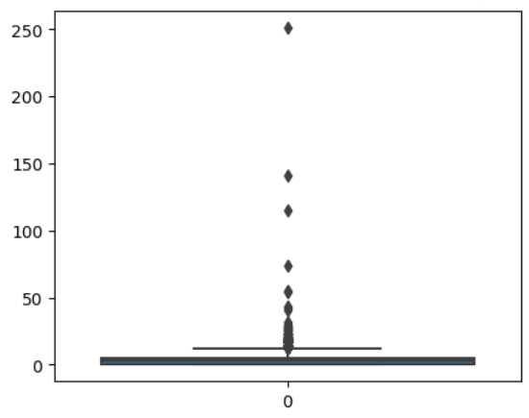
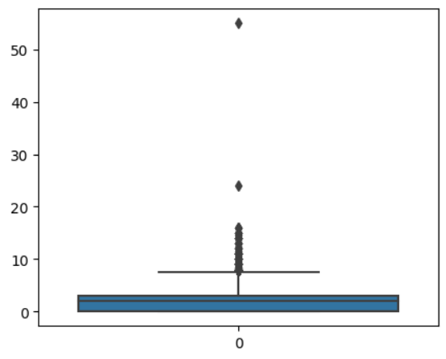
Outlier Treatment
looking for outliers in numerical data in Total Visits
looking for outliers in numerical data in Page Views Per Visit

Slide 6
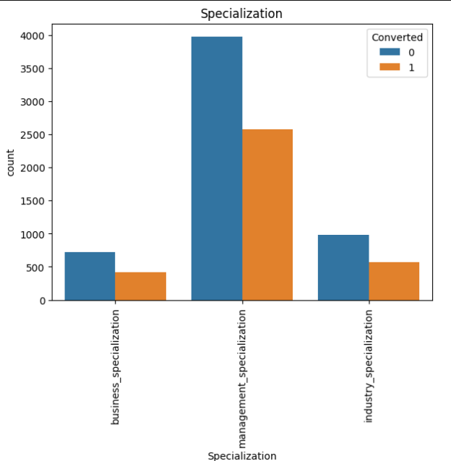
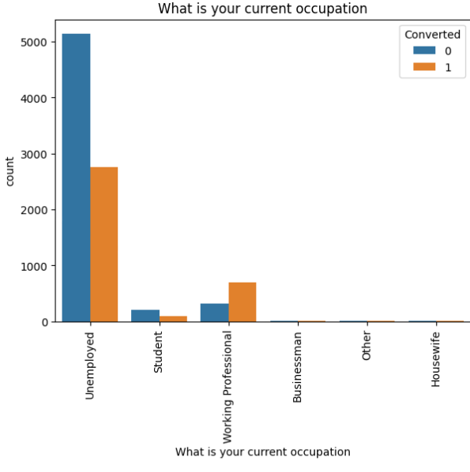
BIVARIATE ANALYSIS
In the first graph, we can see that the management specialization has the highest count.
In the second graph, we can observe that most individuals are unemployed.

Slide 7
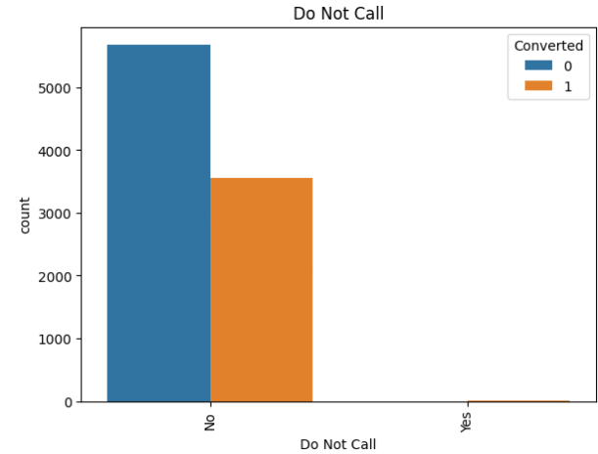
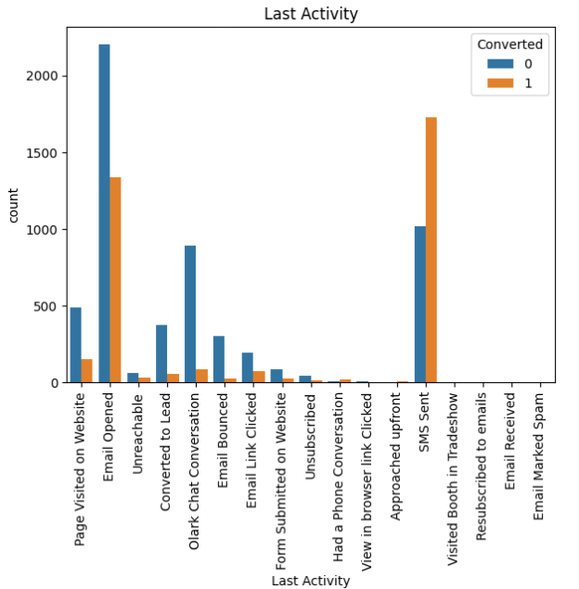
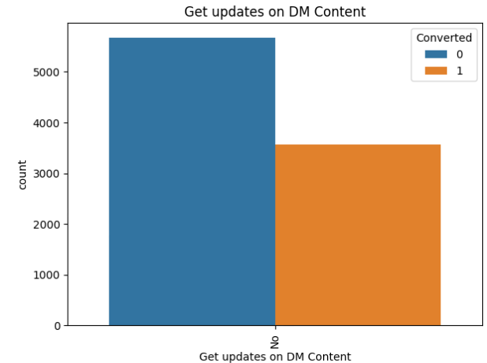
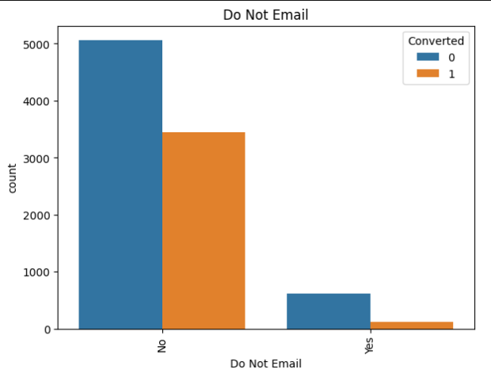
BIVARIATE ANALYSIS
In the last activity, email opens have the highest count.
The majority of people have not interacted with the email.

Slide 8
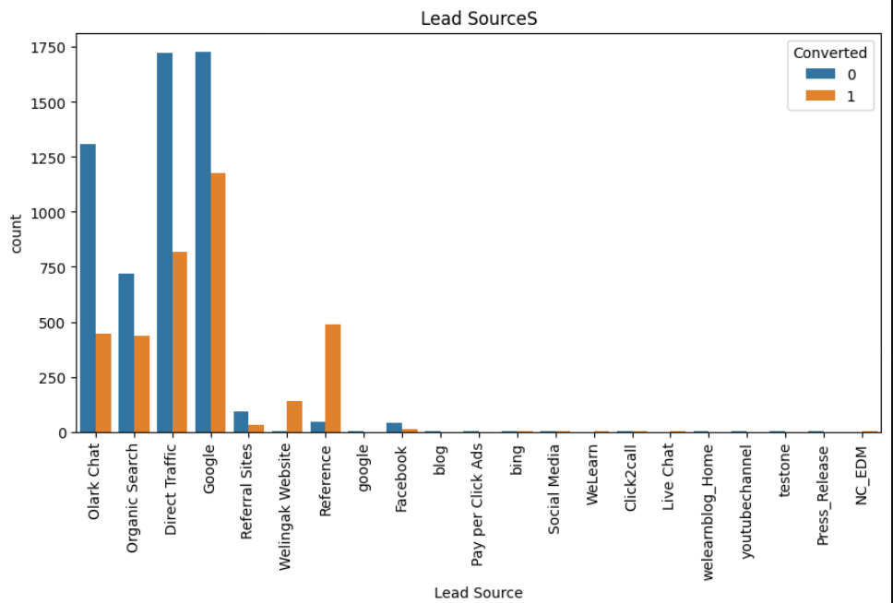

Slide 9
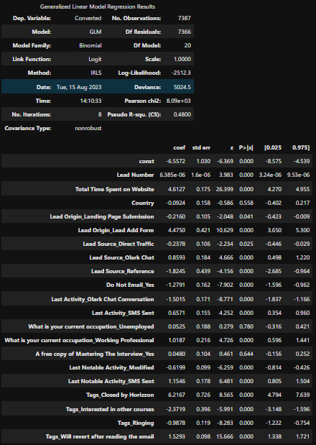
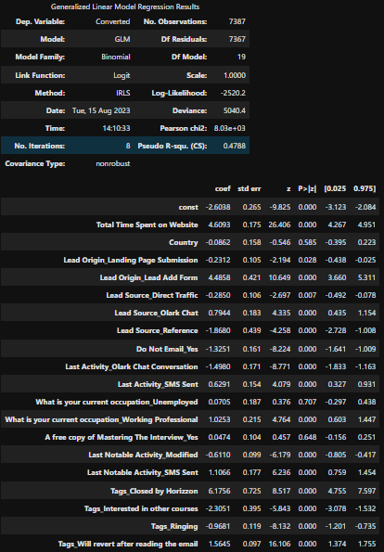
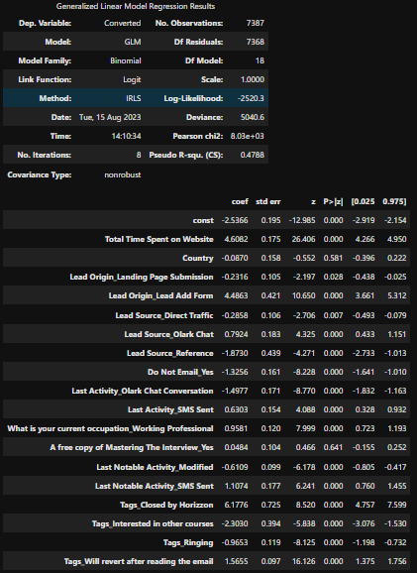
Model Building
Model 1
Model 2
Model 3

Slide 10
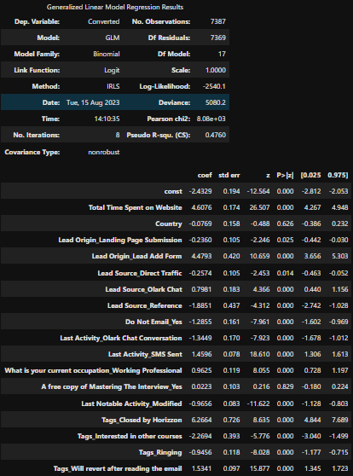
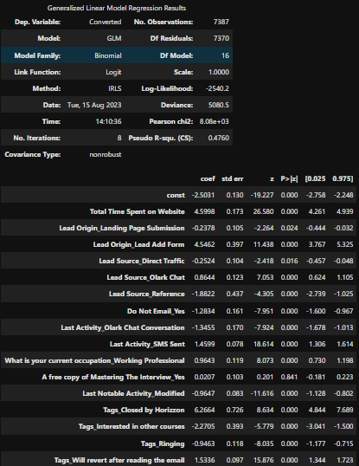
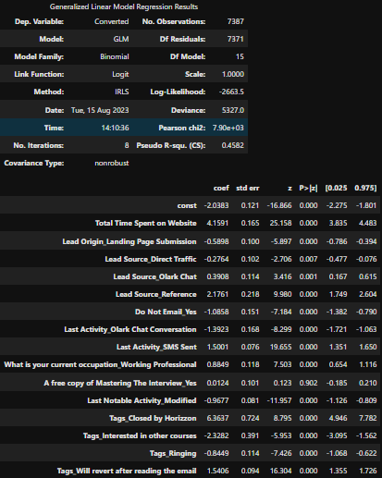
Model Building
Model 4
Model 5
Model 6

Slide 11
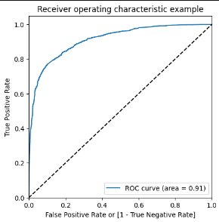
Optimising Cut-off

Slide 12
We found that the variables that mattered the most in the potential buyers are :
Total Time Spent on Website
Lead Origin : Landing Page Submission
Lead Source : Direct Traffic
Lead Source : Olark Chat
Lead Source : Reference
Do Not Email : Yes
Last Activity : Olark Chat Conversation
Last Activity : SMS Sent
What is your current occupation : Working Professional
Last Notable Activity : Modified
Tags : Closed by Horizzon
Tags : Interested in other courses
Tags : Ringing
Tags : Will revert after reading the email

